Slide 1
TravelNow Testing
3SC3/GROUP 4:
Christian Frans Mukuan (1920010040)
Deyaninta Ekabriela Permata (1920010050)
Notes:
HELLO! We are from group 4
My name is Deyaninta Ekabriela Permata and my friends name is Christian Frans Mukuan.
Today we are going to presentate our project, name TravelNow Testing. So, lets begin!

Slide 2


Agenda
01
02
03
What is TravelNow?
White Box Testing
Black Box Testing

Slide 3
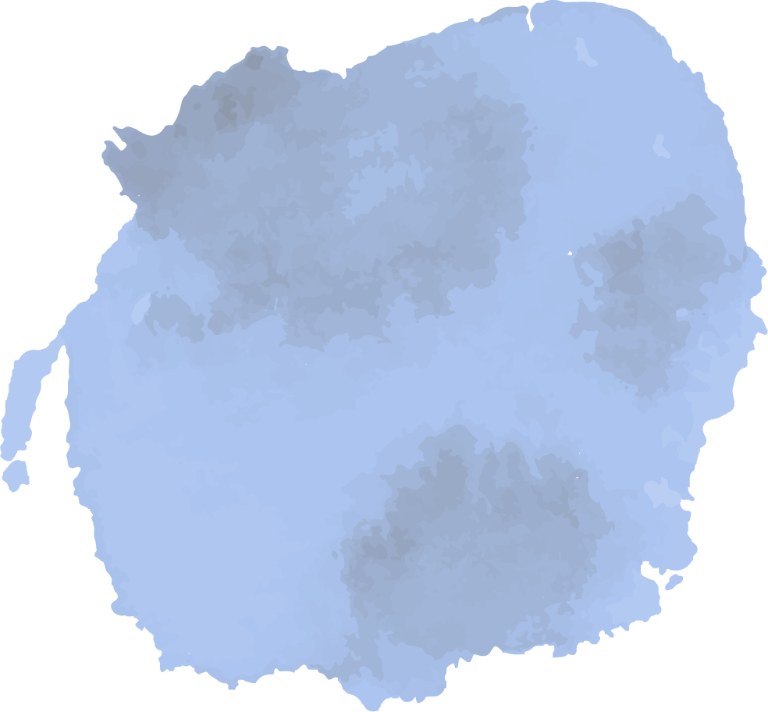

01
What is TravelNow?
Notes:
TravelNow is an Indonesian startup company that provides flight ticket booking services, hotel tickets, tour tickets, transportation services that are complemented by tour guide services to accompany customers on international holidays to several Asian countries. Based on operations in Jakarta, TravelNow is focused on helping to manage the needs of Indonesian public holidays or business trips.
and in this project, we use JUnit, Jacoco, and Blackbox testing.

Slide 4
02
WhiteBox Testing

Slide 5
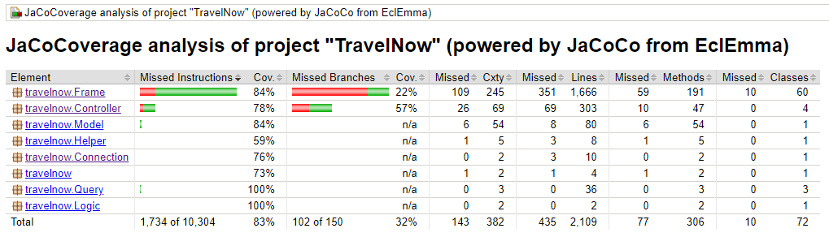
Java Code Coverage

Slide 6
03
BlackBox Testing
Notes:
Black Box Testing, is a software testing method in which the internal structure/ design/ implementation of the item being tested is not known to the tester

Slide 7
BlackBox Testing
No. | Test Case | Test Data | Expected Result | Actual Result | Result
1. | Verification Login for Users | Using valid id and password | Go to the users page | Go to the users page and show “Login Success” | PASS
2. | Verification Login for Users | Using invalid id and password | Go to the login page | Go to the login page and show “Login Failed” | PASS
3. | Verification Login for Admin | Using valid Id and password | Go to the admin panel page | Go to the admin panel page | PASS
4. | Verification Login for Admin | Using invalid id and password | Go to the login page | Go to the login page and show “Login Failed” | PASS
5. | Registration account for users | Fill the users data in the register page | Your data have been submitted | Your data have been submitted and go the login page | PASS
6. | Submit Button | To make a bookings in the users page | Your bookings success | Your data have been submitted and go the passengers details page | PASS
7. | Submit button | To fill the data passengers details | Your data have been submitted | Your data have been submitted | PASS
Notes:
So, in our project, we use blackbox testing to make sure that our interface is works.
we make a test case such as verification login for users and admin,

Slide 8


No. | Test Case | Test Data | Expected Result | Actual Result | Result
1. | Verification Login for Users | Using valid id and password | Go to the users page | Go to the users page and show “Login Success” | PASS
2. | Verification Login for Users | Using invalid id and password | Go to the login page | Go to the login page and show “Login Failed” | PASS
3. | Verification Login for Admin | Using valid Id and password | Go to the admin panel page | Go to the admin panel page | PASS
4. | Verification Login for Admin | Using invalid id and password | Go to the login page | Go to the login page and show “Login Failed” | PASS
5. | Registration account for users | Fill the users data in the register page | Your data have been submitted | Your data have been submitted and go the login page | PASS
6. | Submit Button | To make a bookings in the users page | Your bookings success | Your data have been submitted and go the passengers details page | PASS
7. | Submit button | To fill the data passengers details | Your data have been submitted | Your data have been submitted | PASS

Slide 9
No. | Test Case | Test Data | Expected Result | Actual Result | Result
8. | Delete the user’s bookings data | Delete data bookings by clicking the cancel button | The data bookings have been deleted | The data bookings have been deleted | PASS
9. | Delete the hotel data on the table hotel list | Admin can choose one of the hotel data and click the delete button | The hotel data have been deleted | The hotel data have been deleted | PASS
10. | Delete the airlines data on the table airlines list | Admin can choose one of the airlines data and click the delete button | The airlines data have been deleted | The airlines data have been deleted | PASS
11. | Delete the packets data on the table packets list | Admin can choose one of the packets data and click the delete button | The packets data have been deleted | The packets data have been deleted | PASS
12. | Update the hotel data on the table hotel list | Admin can update the hotel data on the text area and click the update button | The hotels data have been updated | The hotels data have been updated | PASS
13. | Update the airlines data on the table airlines list | Admin can update the airlines data on the text area and click the update button | The airlines data have been updated | The airlines data have been updated | PASS

Slide 10
No. | Test Case | Test Data | Expected Result | Actual Result | Result
8. | Delete the user’s bookings data | Delete data bookings by clicking the cancel button | The data bookings have been deleted | The data bookings have been deleted | PASS
9. | Delete the hotel data on the table hotel list | Admin can choose one of the hotel data and click the delete button | The hotel data have been deleted | The hotel data have been deleted | PASS
10. | Delete the airlines data on the table airlines list | Admin can choose one of the airlines data and click the delete button | The airlines data have been deleted | The airlines data have been deleted | PASS
11. | Delete the packets data on the table packets list | Admin can choose one of the packets data and click the delete button | The packets data have been deleted | The packets data have been deleted | PASS
12. | Update the hotel data on the table hotel list | Admin can update the hotel data on the text area and click the update button | The hotels data have been updated | The hotels data have been updated | PASS
13. | Update the airlines data on the table airlines list | Admin can update the airlines data on the text area and click the update button | The airlines data have been updated | The airlines data have been updated | PASS

Slide 11
No. | Test Case | Test Data | Expected Result | Actual Result | Result
14. | Update the packets data on the table airlines list | Admin can update the packets data on the text area and click the update button | The packets data have been updated | The packets data have been updated | PASS
15. | Create the new hotel data on the table hotel list | Admin can add the new hotel data on the text area | The hotel data have been added | The hotel data have been added | PASS
16. | Create the new airlines data on the table airlines list | Admin can add the new airlines data on the text area | The airlines data have been added | The airlines data have been added | PASS
17. | Create the new packets data on the table packets list | Admin can add the new packets data on the text area | The packets data have been deleted | The packets data have been deleted | PASS
18. | Search By Name button | Admin can search the hotel, airlines, and packets data by the name | The data has appeared | The data has appeared | PASS
19. | Search by Price Button | Admin can search the hotel, airlines, and packets data by the price | The data has appeared | The data has appeared | PASS
20. | Log out button | log out the account by clicking the log out button | Show the message “Are you sure?” and click ok butotn | Show the message “Are you sure?” and click ok butotn | PASS

Slide 12

No. | Test Case | Test Data | Expected Result | Actual Result | Result
14. | Update the packets data on the table airlines list | Admin can update the packets data on the text area and click the update button | The packets data have been updated | The packets data have been updated | PASS
15. | Create the new hotel data on the table hotel list | Admin can add the new hotel data on the text area | The hotel data have been added | The hotel data have been added | PASS
16. | Create the new airlines data on the table airlines list | Admin can add the new airlines data on the text area | The airlines data have been added | The airlines data have been added | PASS
17. | Create the new packets data on the table packets list | Admin can add the new packets data on the text area | The packets data have been deleted | The packets data have been deleted | PASS
18. | Search By Name button | Admin can search the hotel, airlines, and packets data by the name | The data has appeared | The data has appeared | PASS
19. | Search by Price Button | Admin can search the hotel, airlines, and packets data by the price | The data has appeared | The data has appeared | PASS
20. | Log out button | log out the account by clicking the log out button | Show the message “Are you sure?” and click ok butotn | Show the message “Are you sure?” and click ok butotn | PASS

Slide 13


Thanks!

